Slide 1



SEO IMPROVEMENT PLAN FOR WERRV
DAB402-23W-001 CAPSTONE PROJECT Winter 2023 - 001
Guided by: Prof. Sodiq Shofoluwe
St. Clair College

Slide 2


Group 10 Members:
Mallika Dsilva - 0787549
Alysia Rebello – 0792184
Archit Asutkar – 0789221
Rahul Sapkal – 0784192
Anurag Rohra - 0794506

Slide 3
Importance of SEO
Problem statement
Objective
Flow Chart
Timeline
Progress
About Werrv
Dataset Description
References
Contents
Challenges

Slide 4
About WerRV
A Start-up in a Mature Industry
Werrv was established in January 2021 with the intention of upending the RV and boat aftermarket parts and service sectors.
Currently, Werrv sells components online in Canada (in both English and French) and the United States (at https://werrv.com/)
WERRV has wide range of customers ranging from retirees to families to millennials and centennials and even include lifetime rvers the one’s who are Dedicated campers and boaters, passionate about lifestyle and spend some portion of every year in their RV.

Slide 5
Importance of SEO Search Engine Optimization (SEO) is crucial for any business or website looking to increase visibility and drive traffic from search engines such as Google, Bing, and Yahoo. Here are some of the reasons why SEO is important: 1.Aligns with Business Goals: A well-crafted SEO implementation plan ensures that your website's optimization efforts are aligned with your overall business goals and objectives. This helps you to prioritize your efforts and allocate resources effectively, leading to better results and a higher return on investment. 2.Facilitates Effective Resource Allocation: An SEO plan allows you to effectively allocate resources, including time, money, and personnel, towards the most important optimization efforts. This helps you to maximize your results and ensure that your website is optimized for the most impactful keywords and phrases. 3.Provides a Clear Roadmap: An SEO plan serves as a roadmap for your optimization efforts, providing a clear and comprehensive guide to the tasks that need to be completed and the timeline for completion. This helps you to stay on track and make progress towards your goals, leading to a more efficient and effective optimization process.

Slide 6

Problem Statement
To enhance the SEO and advertising for Werrv.ca, leading to higher search rankings and improved visibility of products through the utilization of data analytics

Slide 7

Objective
Extracting keyword research from our https://dataforseo.com/ account using some APIs.
Create a repeatable automated procedure to evaluate and narrow down Werrv-relevant SEO and advertising improvements.
Augment results with the use of AI such as GPT-3 API calls, or, if available and applicable, Chat-GPT in beta testing.

Slide 8
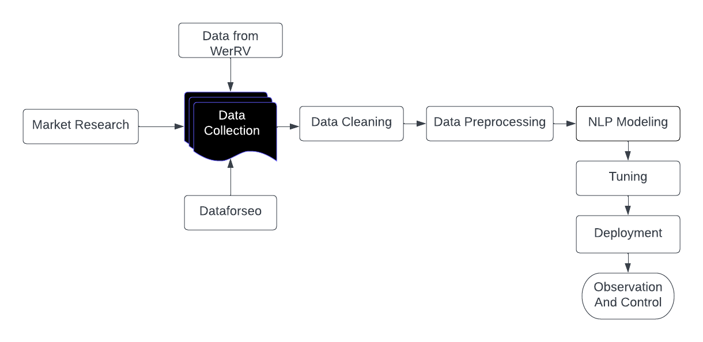
Flow Chart

Slide 9
Tools
Data Preprocessing
Excel
Python
Keyword Research
DataforSeo
GPT-3
Natural Language Processing
NLTK, RE, random, n-gram, bi-gram
SEO Parser
Excel
Google Colab

Slide 10
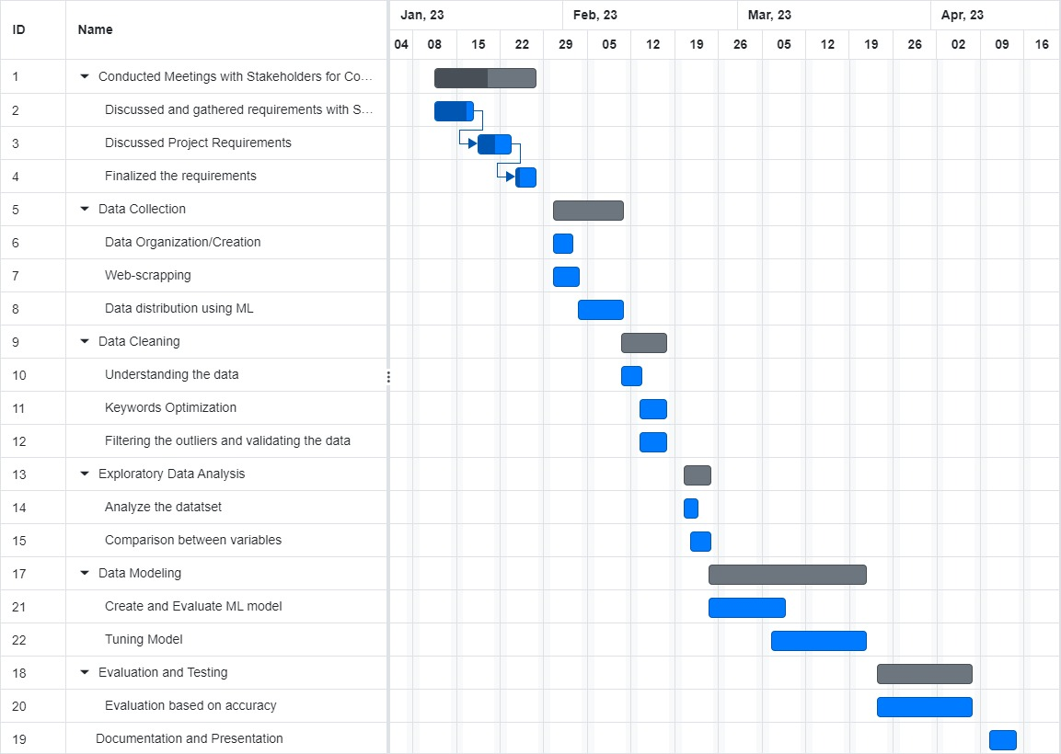
Timeline using Gantt chart

Slide 11


Dataset Description
Product data provided by stakeholder.
The dataset consist of over 300 variables which includes category, product title, product description, product code, product type, brand, vendor name,etc.
DataforSeo
The Dataset consist of various URLs which can be used for relevant keyword search from the descriptions provided.

Slide 12
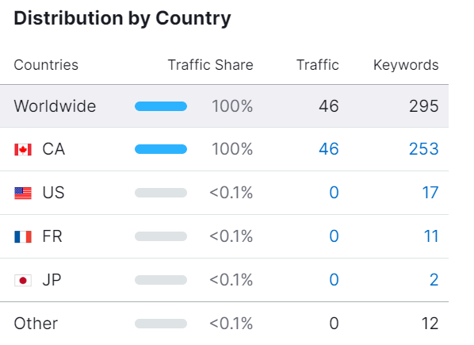
Progress
We conducted multiple trials for summarization on various platforms and discovered that Google Colab was the most user-friendly.
As a result, we have chosen to proceed with using Google Colab.
Developing an implementation using openai API Key and GPT-3 to create keyword generator for the products, website traffic and product description generator.

Slide 13

NLP Code For Text Generation

Slide 14

NLP Code for Text Summarization

Slide 15
Challenges
We have been putting in a lot of effort to run our code, however, we have been facing some difficulties in getting the desired outcomes. Despite trying various debugging techniques, we have not been able to obtain the results we had hoped for. We are starting to think that there might be some underlying issue with the code that is causing it to produce unexpected results. We are continuing to investigate and hope to resolve the issue soon.

Slide 16
References
https://www.seoclarity.net/blog/reporting-on-google-flights
https://www.semrush.com/blog/analyzing-search-engine-results-pages/

Slide 17
Thank you!

